Slide 1

BCA Ist Semester
PROBLEM SOLVING USING COMPUTER
Course Code: BCAC 0018
Presented by:
Mr. Shivank Chauhan
Dept. Of CEA
GLA University, Mathura

Slide 2
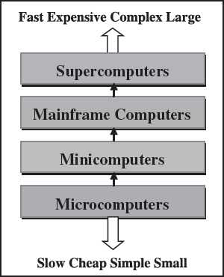
CLASSIFICATION OF COMPUTER
Figure 1.8 Classification of computers based on size and type

Slide 3
Microcomputers
Microcomputers are small, low-cost and single-user digital computer. They consist of CPU, input unit, output unit, storage unit and the software.
Although microcomputers are stand-alone machines, they can be connected together to create a network of computers that can serve more than one user.
Examples of microcomputers:-IBM PC based on Pentium microprocessor and Apple Macintosh
Microcomputers include desktop computers, notebook computers or laptop, tablet computer, handheld computer, smart phones and notebook.

Slide 4
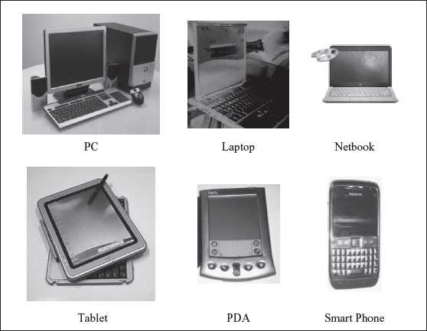
Figure 1.9 Microcomputers

Slide 5
Desktop Computer or Personal Computer (PC)
Desktop Computer or Personal Computer (PC) is the most common type of microcomputer. It is a stand-alone machine that can be placed on the desk.
Externally, it consists of three units—keyboard, monitor, and a system unit containing the CPU, memory, hard disk drive, etc.
It is not very expensive and is suited to the needs of a single user at home, small business units, and organizations.
Apple, Microsoft, HP, Dell and Lenovo are some of the PC manufacturers

Slide 6
Notebook Computers or Laptop
Notebook Computers or Laptop resemble a notebook. They are portable and have all the features of a desktop computer. The advantage of the laptop is that it is small in size (can be put inside a briefcase), can be carried anywhere, has a battery backup and has all the functionality of the desktop.
Laptops can be placed on the lap while working (hence the name). Laptops are costlier than the desktop machines

Slide 7
Netbook
Netbook These are smaller notebooks optimized for low weight and low cost, and are designed for accessing web-based applications.
Starting with the earliest netbook in late 2007, they have gained significant popularity now.
Netbooks deliver the performance needed to enjoy popular activities like streaming videos or music, emailing, Web surfing or instant messaging.
The word netbook was created as a blend of Internet and notebook.

Slide 8
Tablet Computer
Tablet Computer has features of the notebook computer but it can accept input from a stylus or a pen instead of the keyboard or mouse.
It is a portable computer.
Tablet computer are the new kind of PCs.

Slide 9
Handheld Computer or Personal Digital Assistant (PDA)
Handheld Computer or Personal Digital Assistant (PDA) is a small computer that can be held on the top of the palm. It is small in size. Instead of the keyboard.
PDA uses a pen or a stylus for input. PDAs do not have a disk drive. They have a limited memory and are less powerful.
PDAs can be connected to the Internet via a wireless connection. Casio and Apple are some of the manufacturers of PDA.
Over the last few years, PDAs have merged into mobile phones to create smart phones.

Slide 10
Smart Phones
Smart Phones are cellular phones that function both as a phone and as a small PC.
They may use a stylus or a pen, or may have a small keyboard. They can be connected to the Internet wirelessly.
They are used to access the electronic-mail, download music, play games, etc.
Blackberry, Apple, HTC, Nokia and LG are some of the manufacturers of smart phones

